Slide 1

FIRE Analysis 🔥
PAMELA MORENO
RAJ MOHAPATRO
JEAN-CHRISTOPHE MIGNON

Slide 2
Motivation & Summary
James is keen to retire early, based on the FIRE principle. He’d like to assess based on his age, savings and lifestyle what that would look like. Unfortunately, James will have to work a long time to reach Financially Independent Retire Early status. A wise person suggests James to invest on the stock exchange, to speed up the process. James would like to see some proof of what that would look like. A brilliant tool is shown to James, which has 10, 20 and 30 year return simulations including risk assessment.
James, is also thinking that if he could save a bit of money on cost living, he would end up with more and having a good retirement life. So for that, James would like to analysis the cost living expenses in different countries and see if he better off moving into another country.

Slide 3

Research questions
Could James achieve FIRE status? Are there ways to speed up the process?
The hypothesis supports that investing would be a wise decision. What investment strategy would we recommend for James based on investment duration (10y / 20y / 30y) & risk.
If James would relocate, given the savings he would have at the time of what would be a an interesting location for James?

Slide 4
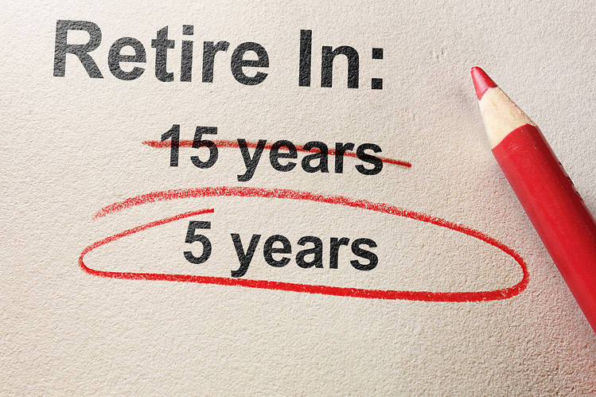
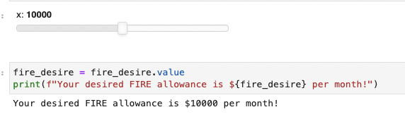
Data Analysis - FIRE Calculator

Slide 5
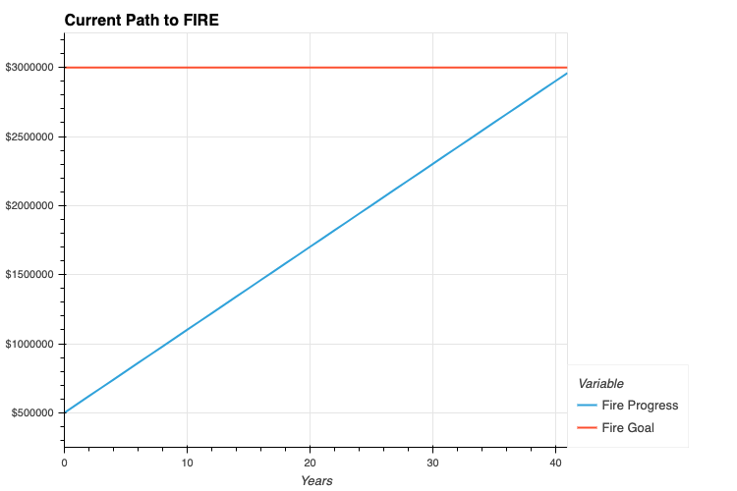
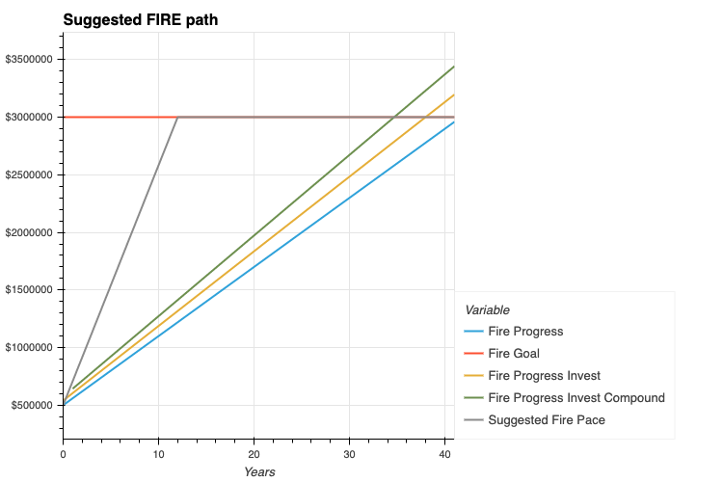

Data Analysis - FIRE Calculator
Plot FIRE simulations
Assess based on preferred criteria what FIRE simulation would be possible

Slide 6
Required Project Data
FIRE Calculator
Personal finance data required
Average market returns
Market Analysis & Retirement Tool Data :
yfinance to fetch historical data of 5 major Indexes markets.
au.finance.yahoo.com/ to collect the historical data of S&P500, NASDAQ Composite, S&P/ASX 200, Dow Jones Commodity & BTC.
Cost of living analysis Data: (Raj)
It fetches data from world bank for per capita expenditure analysis
Fetches data from Nomatin using geopy to get longitude and latitude data.

Slide 7
Data Clean Up
Market Analysis & Retirement Tool Data :
Indexes Analysis: at first, we tried to use Alpaca to get the data history of the selected Indexes market, but this was not possible due to Alpaca does not contain Indexes Tickers. So instead, we used yfinance and get data from https://au.finance.yahoo.com/.
We then, started cleaning it up and selected “close” price to start our analysis. Some other changes was columns names.

Slide 8
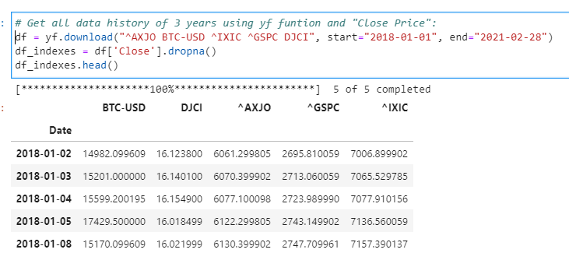
Data Cleanup & Exploration
For our retirement plan tool data, we found out that the data levels are opposite to what MCSimulation is structured, so we had to swapped levels and changed names to lower case:

Slide 9
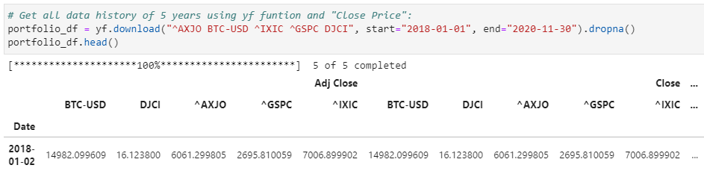
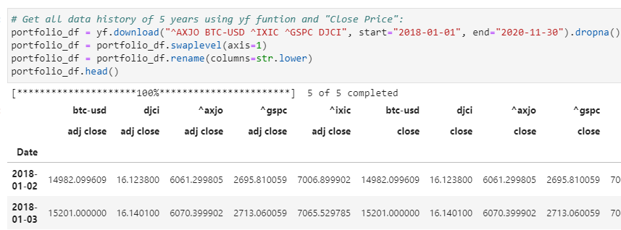
Data Cleanup & Exploration
First Df 🡪
🡨 Second Df

Slide 10
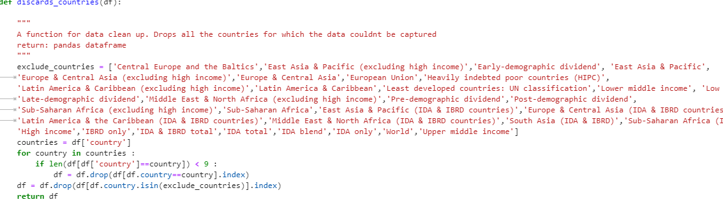
Data Cleanup & Exploration
Cost of living analysis Data
Data pulled from Worldbank using wbdata framework didn’t have per capita income values for all the countries for last 10 years.
So these countries had to be filtered out for accurate forecast analysis
The returned response contained info about regions and continents. Those had be filtered out to make it work for per capita by country format.

Slide 11
Data Analysis - Indexes Analysis
Indexes:
1. S&P500 (GSPC).
2. NASDAQ Composite (IXIC).
3. S&P/ASX 200 (ASX).
4. DJCI (Dow Jones Commodity)
5. BTC.

Slide 12
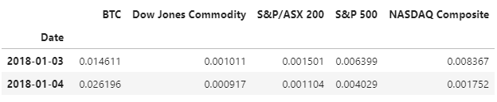
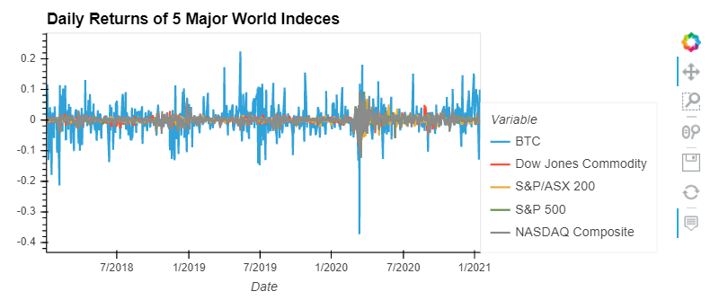
Data Analysis
We have analysed these major indexes to determine their performance in multiple areas: volatility, returns, risk, and Sharpe ratios
Daily Returns

Slide 13
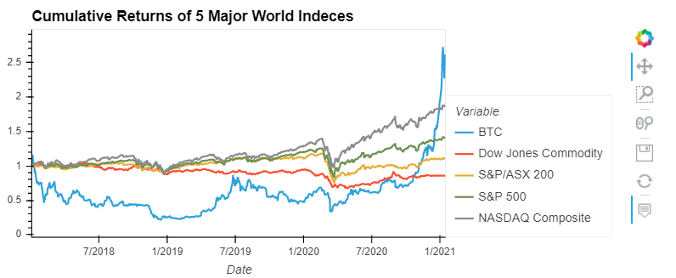

Data Analysis
Cumulative Returns 🡪
🡨 Risk Analysis: Standard Deviation

Slide 14
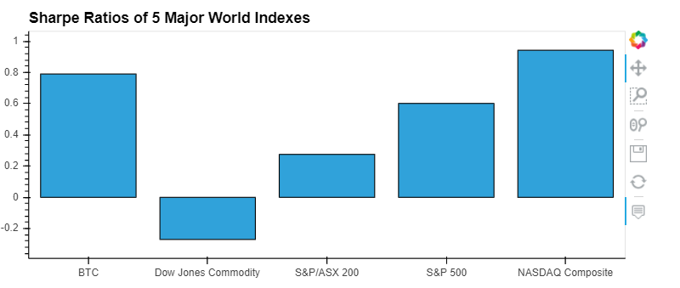
Data Analysis

Slide 15
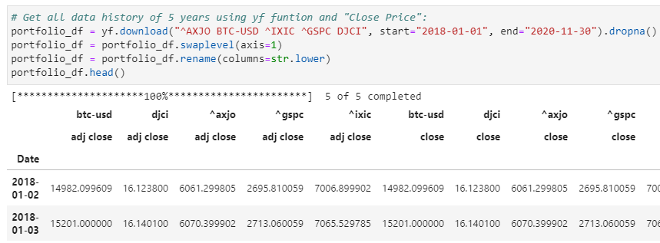
Data Analysis
Part 2 - Retirement Plan Tool:

Slide 16
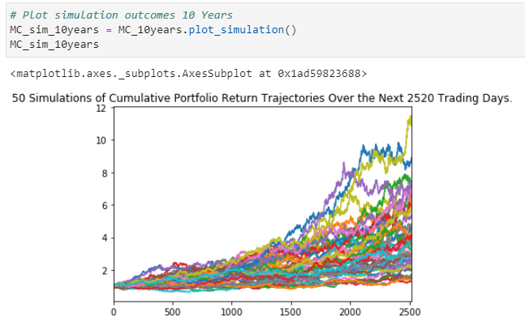
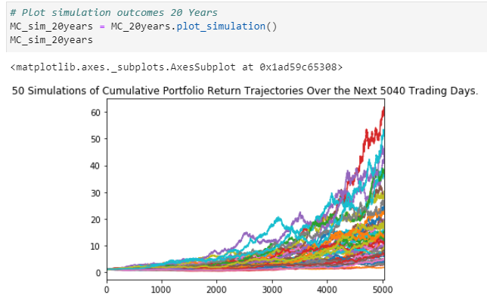
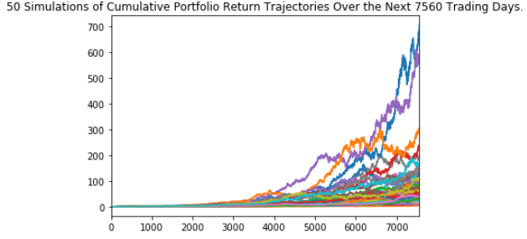
Data Analysis

Slide 17
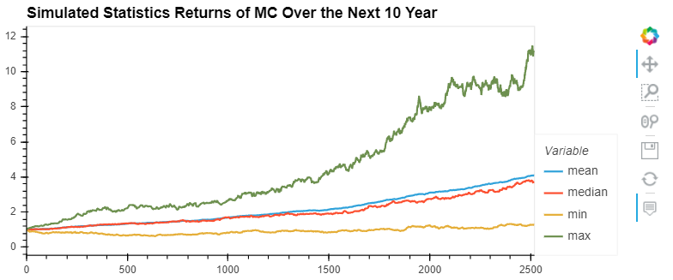
Data Analysis
Retirement Analysis:

Slide 18
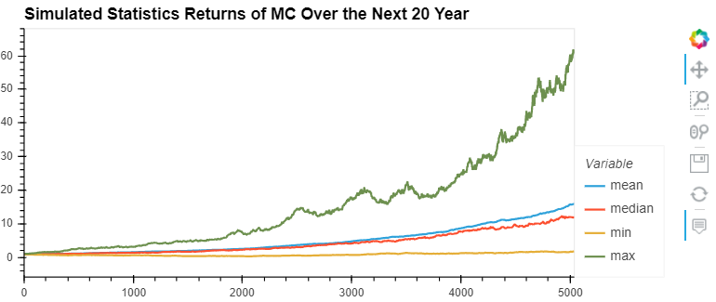
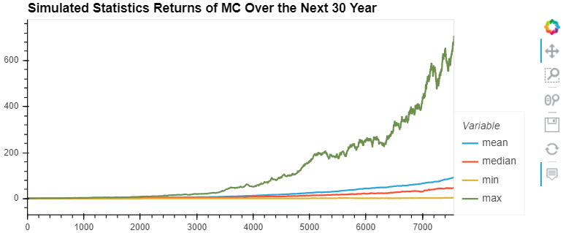
Data Analysis

Slide 19
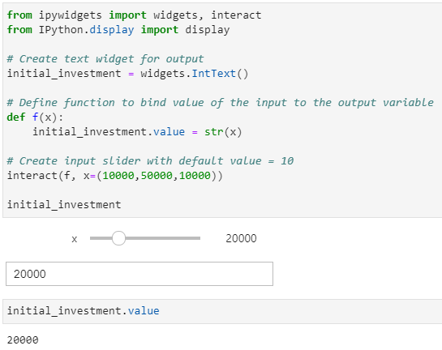
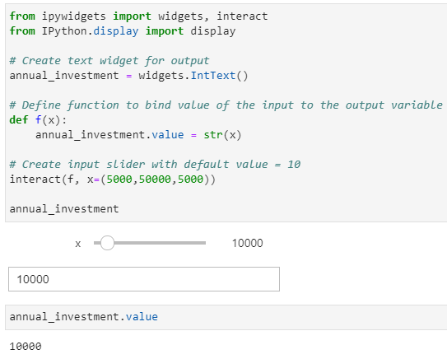
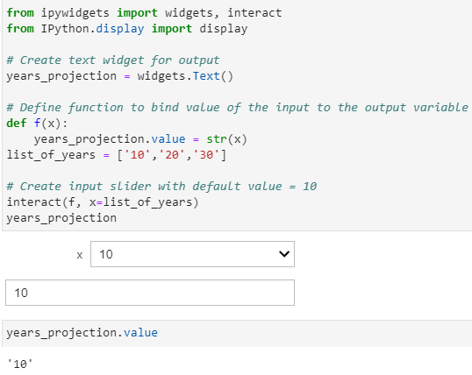
Data Analysis

Slide 20
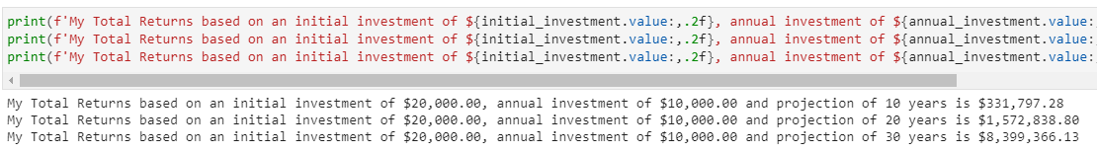
Data Analysis

Slide 21
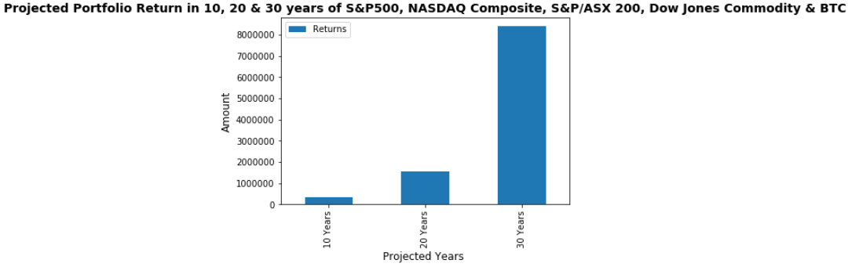
Data Analysis

Slide 22
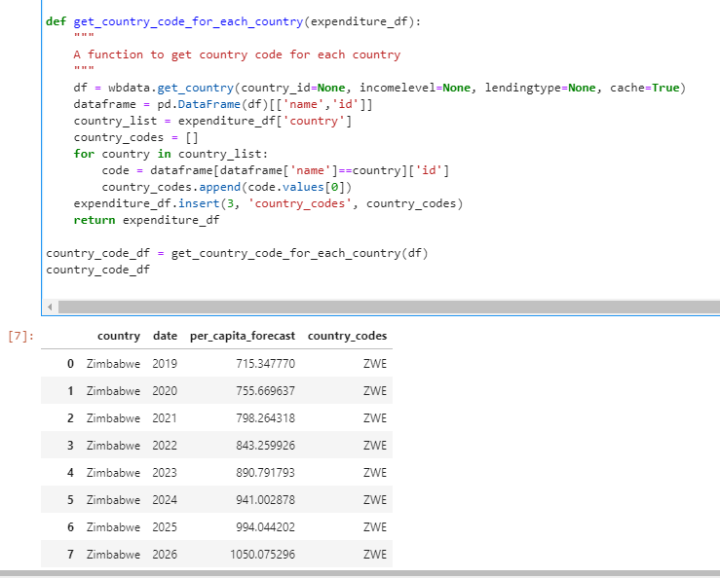
Data Analysis
Cost of living analysis :

Slide 23
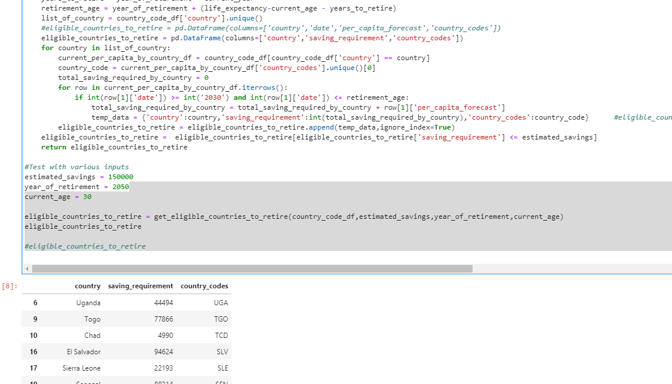
Data Analysis
Cost of living analysis :

Slide 24
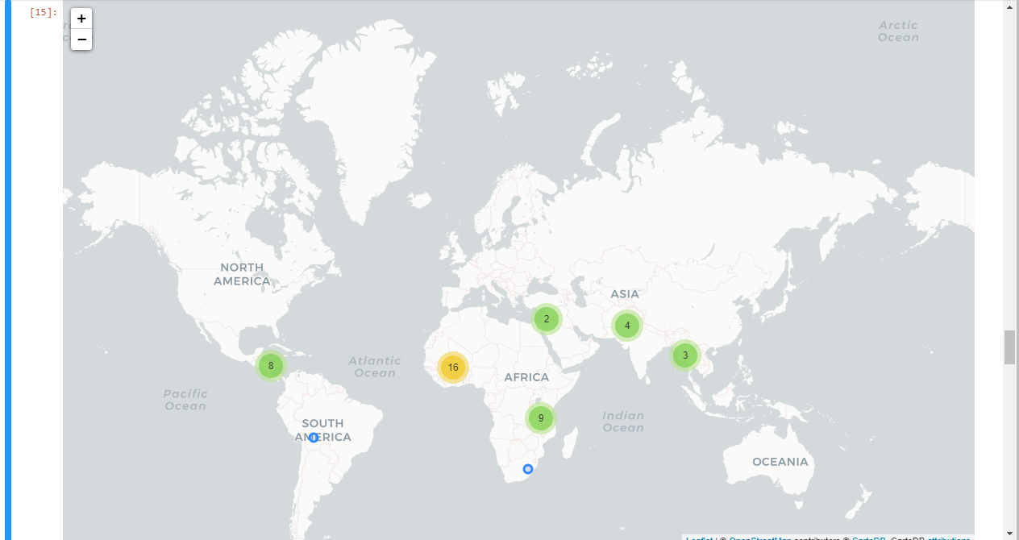
Data Analysis
Cost of living analysis :

Slide 25
Discussion
The assumption was that FIRE status is difficult to achieve
It can be done with a good investment portfolio
The forecasted saving input value should be accurate

Slide 26
Post Mortem
Spend sufficient amount brainstorming,
Split up priority objectives vs. nice to haves
Set up a Minimum Viable Product (deadline)
Don’t get stuck on roadblocks, keep making progress Fix the small roadblocks at the end

Slide 27
Feedback & Questions

